Slide 1
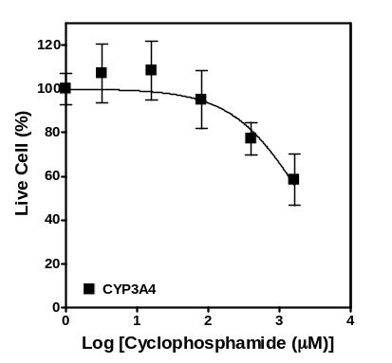
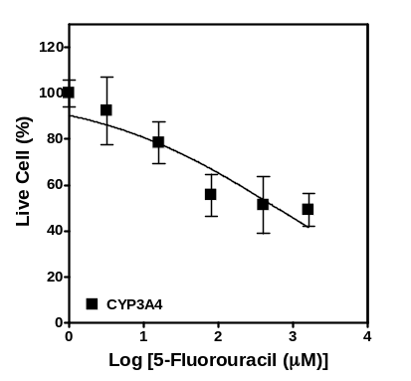
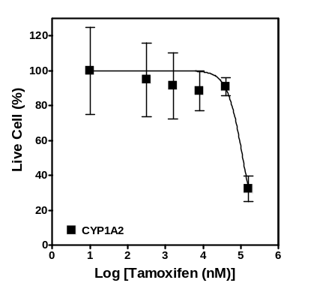
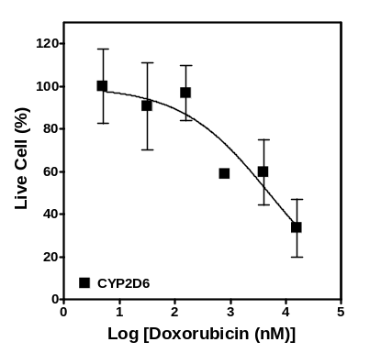
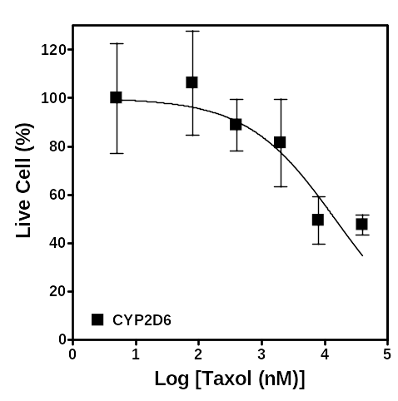
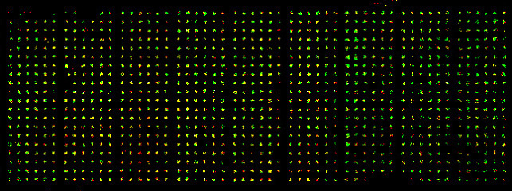
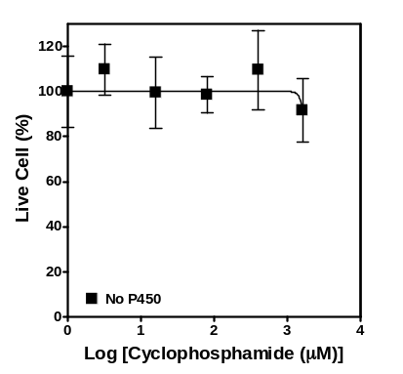
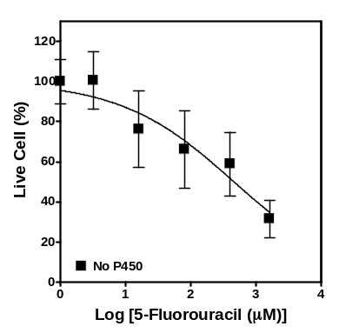
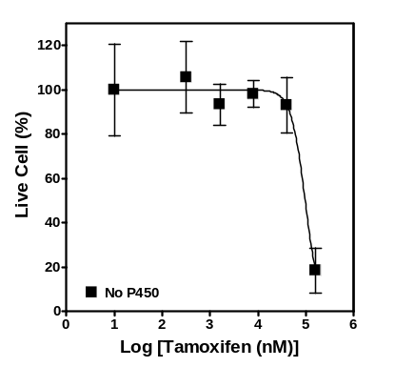
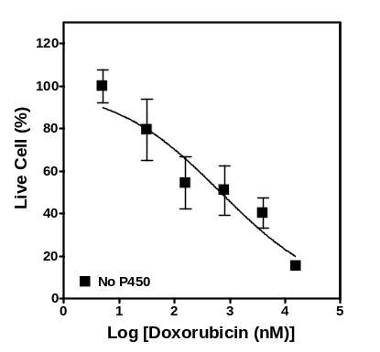
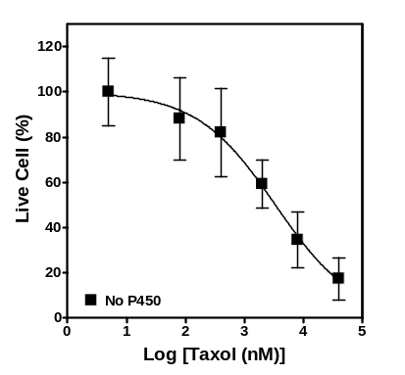
Cytotoxicity testing on DataChip: 1080 spots, 9 Compounds, 5 P450 enzymes
Notes:
For example, a single MetaChip and the corresponding cell-culture chip enables us to screen 9 compounds against 5 P450s and/or P450 mixtures, or against so-called secondary metabolizing enzymes, using 6 concentrations and 4 replicates. And shown here are a few dose-response curves corresponding to the different regions on the chip.
9 compounds, 5 expts. per compound, 45 regions of 6 (doses) x 4 replicates; cells grown for 1 day; MC spotted and then stamped for 6 hr on 1-day old cells, removed; additional incubation for 3 days; then stained for ~30 minutes

Slide 2
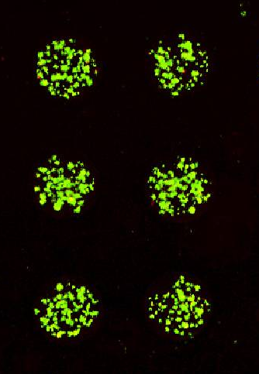
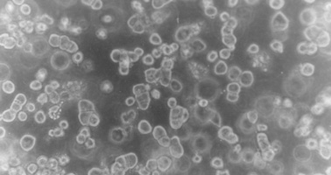
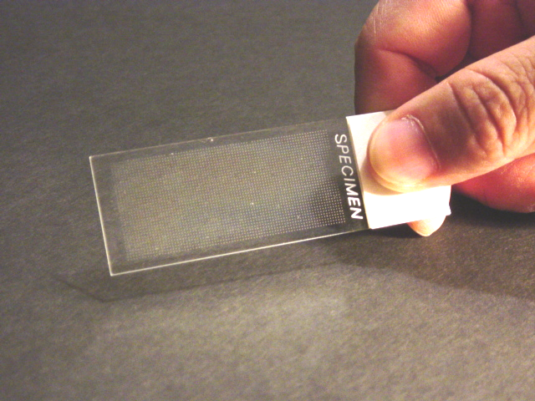
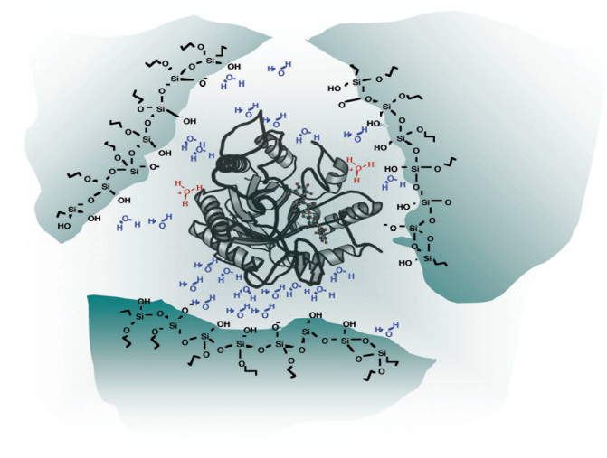
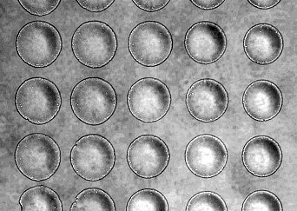
DataChip
Encapsulated cells
Encapsulated enzymes
MetaChip
Notes:
These pictures show the three dimensional cellular microarray. Each glass slide contains about 600 cell spots, containing 75 cells per spot. The diameter of the spots are about 600 micron. This picture shows live cells stained with calcein, which fluoresce green.

